Slide 1
電腦視覺與深度學習 (Computer Vision and Deep Learning) Homework 1
TA:
真禎: nckubot65904@gmail.com
Office Hour: 14:00~16:00, Mon.
10:00~12:00, Fri.
At CSIE 9F Robotics Lab.

Slide 2
Notice (1/2)
Copying homework is strictly prohibited!! Penalty: Score will be zero for both persons!!
Due date => 09:00:00, 2022/10/20 (Thu.)
No delay. Penalties for late homework:
Up to 7 days late, loss of 50% of the score awarded
After 7 days, the score will be marked as 0.
You must attend the demonstration, or your score will be 0. The demonstration schedule will be announced on NCKU moodle.
You must make a GUI, or you will get some penalties.
Upload to => 140.116.154.1 -> Upload/Homework/Hw1_1
User ID: cvdl2022 Password: cvdl2022
Format
Filename: Hw1_StudentID_Name_Version.rar
Ex: Hw1_1_F71234567_林小明_V1.rar
If you want to update your file, you should update your version to be V2, ex: Hw1_1_F71234567_林小明_V2.rar
Content: project folder*( excluding the pictures ) *note: remove your “Debug” folder to reduce file size
2

Slide 3
Notice (2/2)
Python (recommended)
Python 3.7 (https://www.python.org/downloads/)
opencv-contrib-python (3.4.2.17)
Matplotlib 3.1.1
UI framework: pyqt5 (5.15.1)
C++ (check MFC guide in ftp)
OpenCV 3.3.1 (https://opencv.org/release.html)
Visual Studio 2015 (download from http://www.cc.ncku.edu.tw/download/)
UI framework: MFC
3
Notes:
https://ithelp.ithome.com.tw/articles/10210071
pip install opencv-contrib-python==3.4.2.17
pip install matplotlib==3.1.1
pip install pyqt5==5.15.1

Slide 4
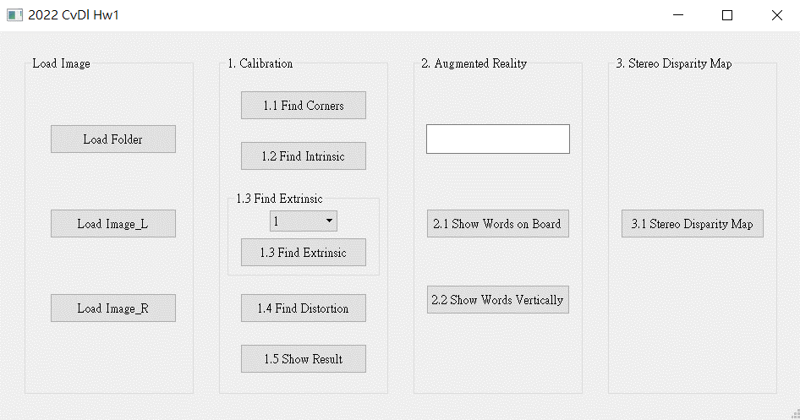
Assignment scoring (Total: 100%)
1. (20%) Camera Calibration
1.1 (4%) Corner detection
1.2 (4%) Find the intrinsic matrix
1.3 (4%) Find the extrinsic matrix
1.4 (4%) Find the distortion matrix
1.5 (4%) Show the undistorted result
2. (20%) Augmented Reality
2.1 (10%) Show words on board
2.2 (10%) Show words vertically
3. (20%) Stereo Disparity Map
3.1 (10%) Stereo Disparity Map
3.2 (10%) Checking the Disparity Value
4. (20%)
5. (20%)
(出題：Jessica)
(出題：Ming)
(出題：Maton)
Don’t fix your image path
(There is another dataset for demonstration)

Slide 5
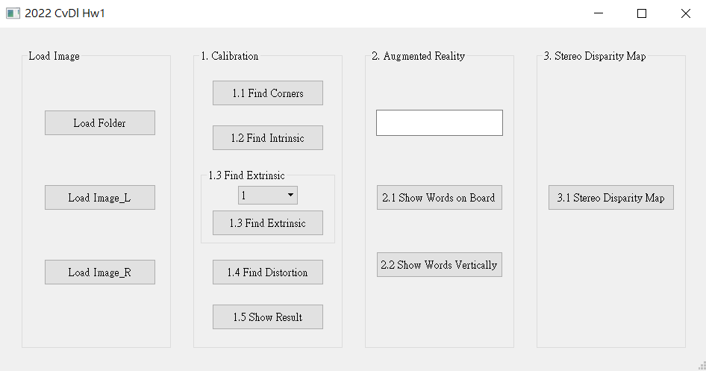
1. (20%) Camera Calibration
(出題：Jessica)
1.1 (4%) Corner detection
1.2 (4%) Find the intrinsic matrix
1.3 (4%) Find the extrinsic matrix
1.4 (4%) Find the distortion matrix
1.5 (4%) Show the undistorted result
Load all images in the folder
Notes:
https://silverwind1982.pixnet.net/blog/post/258069682-三維旋轉表示法---歐拉角、旋轉矩陣、旋轉向

Slide 6
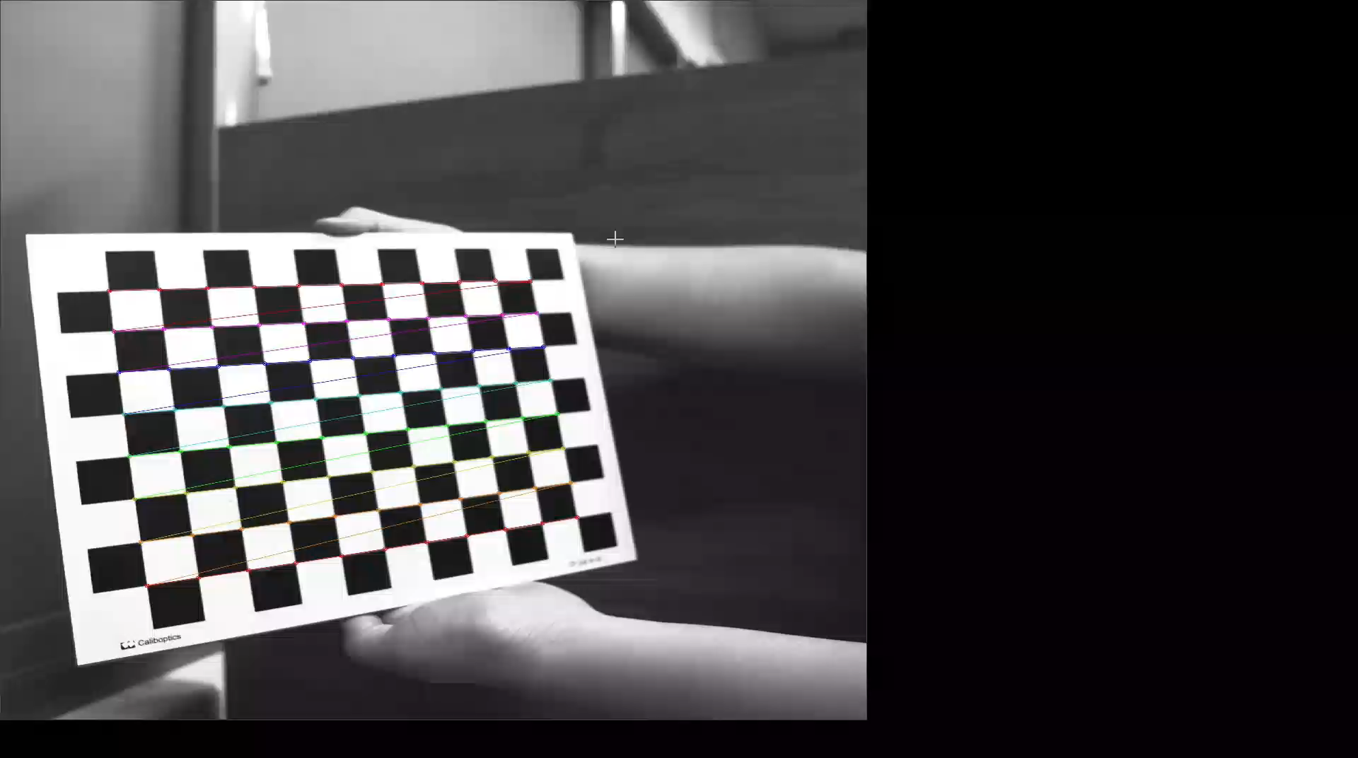
1.1 Corner Detection (4%)
(出題：Jessica)
Given: 15 images, 1.bmp ~ 15.bmp
Q: 1) Find and draw the corners on the chessboard for each image.
2) Click button “1.1” to show each picture 0.5 seconds.
Hint :
OpenCV Textbook Chapter 11 (p. 398 ~ p. 399)
cv.findChessboardCorners(…)
Ex:
6
Notes:
https://blog.csdn.net/u010128736/article/details/52875137
https://www.cnblogs.com/ybqjymy/p/15936311.html (找到點積皆為0的q點)

Slide 7
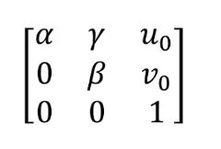
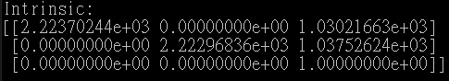
1.2 Find the Intrinsic Matrix (4%)
(出題：Jessica)
Given: 15 images, 1.bmp ~ 15.bmp
Q: 1) Find the intrinsic matrix ():
2) Click button “1.2” and then show the result on the console window.
Output format:
Hint: OpenCV Textbook Chapter 11 (P.398 ~ p.400)
(Just an example)
Notes:
https://blog.csdn.net/qq_32998593/article/details/113063216

Slide 8
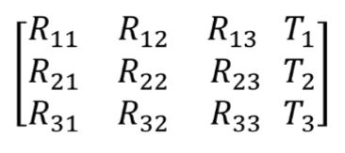
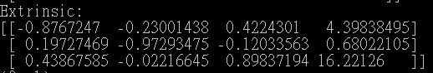
1.3 Find the Extrinsic Matrix (4%)
(出題：Jessica)
Given: Intrinsic parameters, distortion coefficients, and the list of 15 images
Q: 1) Find the extrinsic matrix of the chessboard for each of the 15 images, respectively:
2) Click button “1.3” and then show the result on the console window.
Output format:
Hint: OpenCV Textbook Chapter 11, p.370~402
(Just an example)
(1) List of numbers: 1~15
(2) Select 1, then 1.bmp will be applied, and so on
Notes:
https://zhuanlan.zhihu.com/p/259999988

Slide 9
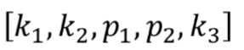
1.4 Find the Distortion Matrix (4%)
(出題：Jessica)
Given: 15 images
Q: 1) Find the distortion matrix:
2) Click button “1.4” to show the result on the console window.
Output format:
Hint:
Distortion coefficients can be obtained simultaneously with intrinsic parameters
OpenCV Textbook Chapter 11 (P.398 ~ p.400)
(Just
an example)
Notes:
https://blog.csdn.net/dgut_guangdian/article/details/107467070

Slide 10
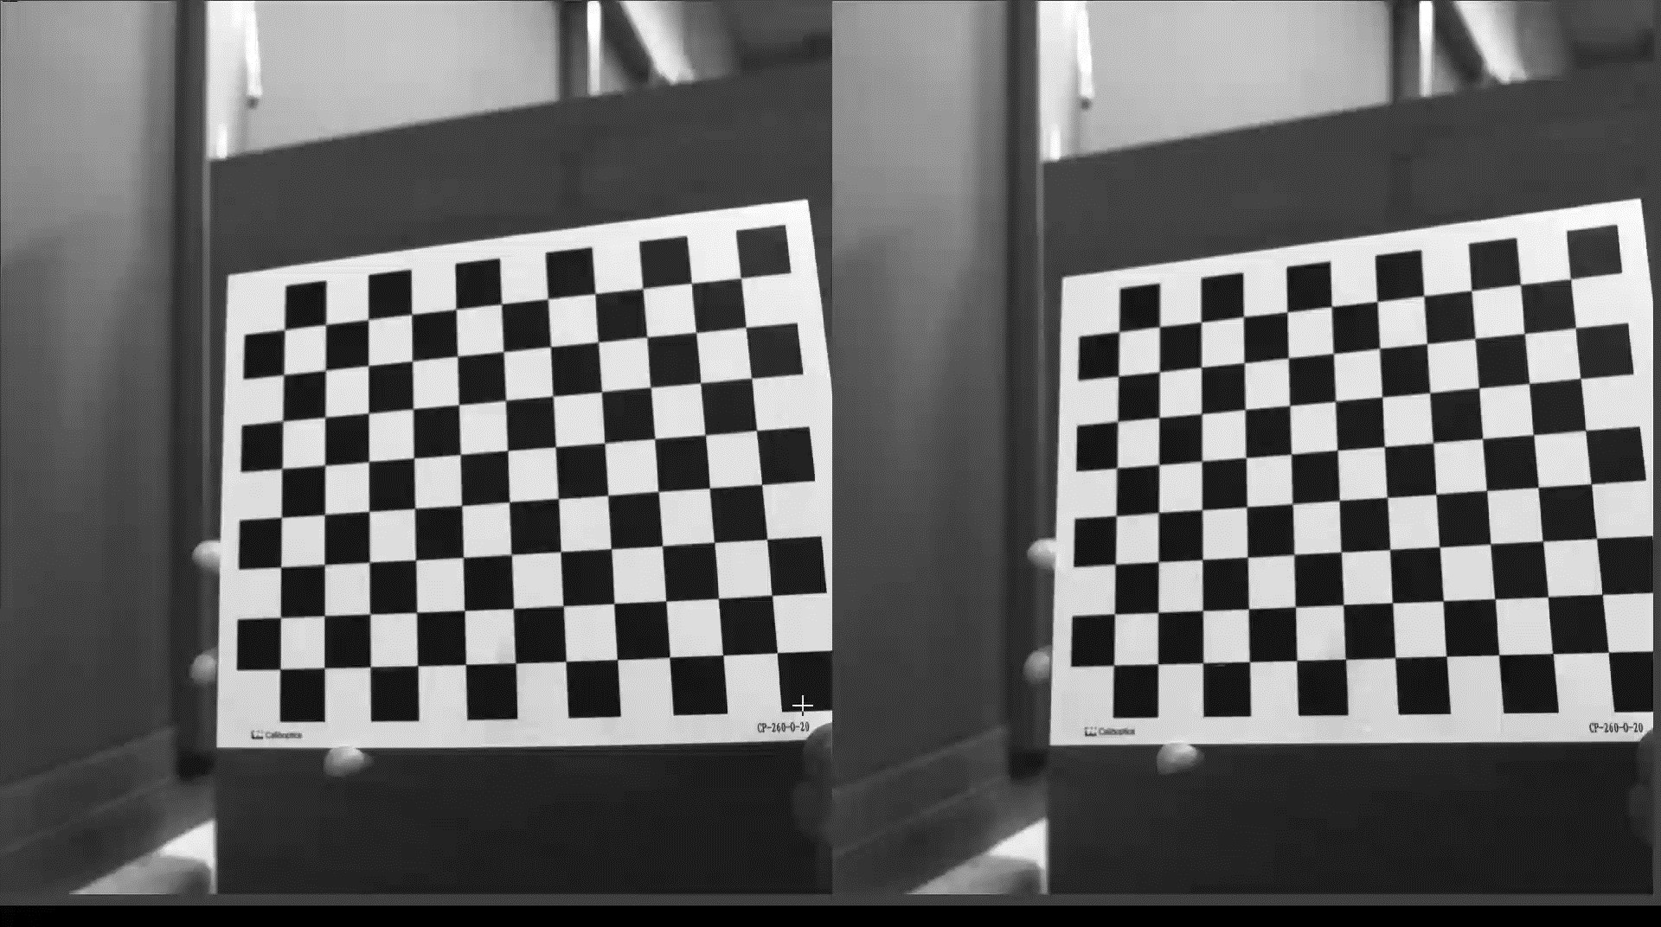
1.5 Show the undistorted result (4%)
(出題：Jessica)
Given: 15 images
Q: 1) Undistort the chessboard images.
2) Show distorted and undistorted images.
Hint:
cv::undistort(…) or cv::initUndistortRectifyMap(…)
OpenCV Textbook Chapter 11 (P.398 ~ p.400)
Distorted image
Undistorted image
Notes:
https://blog.csdn.net/u010128736/article/details/52875137#t3

Slide 11
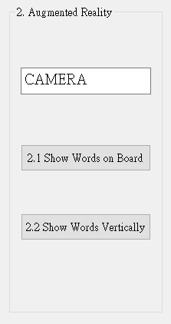
2. (20%) Augmented Reality
(出題：Ming)
2.1 (10%) Show words on board
2.2 (10%) Show words vertically
Load all images in the folder

Slide 12
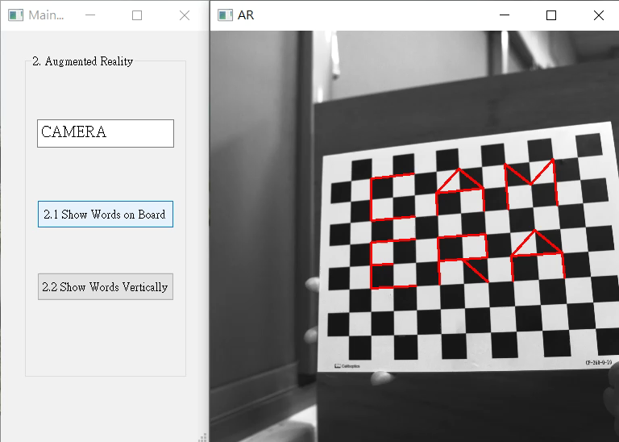
2. (20%) Augmented Reality
(出題：Ming)
Given: 5 images: 1~5.bmp
Q:
1) Calibrate 5 images to get intrinsic, distortion and extrinsic parameters
2) Input a “Word” less than 6 char in English in the textEdit box
3) Derive the shape of the “Word” by using the provided library
4) Show the “Word” on the chessboards images(1.bmp to 5.bmp)
5) Show the “Word” vertically on the chessboards images(1.bmp to 5.bmp)
6) Click the button to show the “Word” on the picture. Show each picture for 1 second (total 5 images)
Demo:
Hint : Textbook Chapter 11,
p.387~395 Calibration
p.405~412 Projection
cv2.calibrateCamera()
cv2.projectPoints()

Slide 13
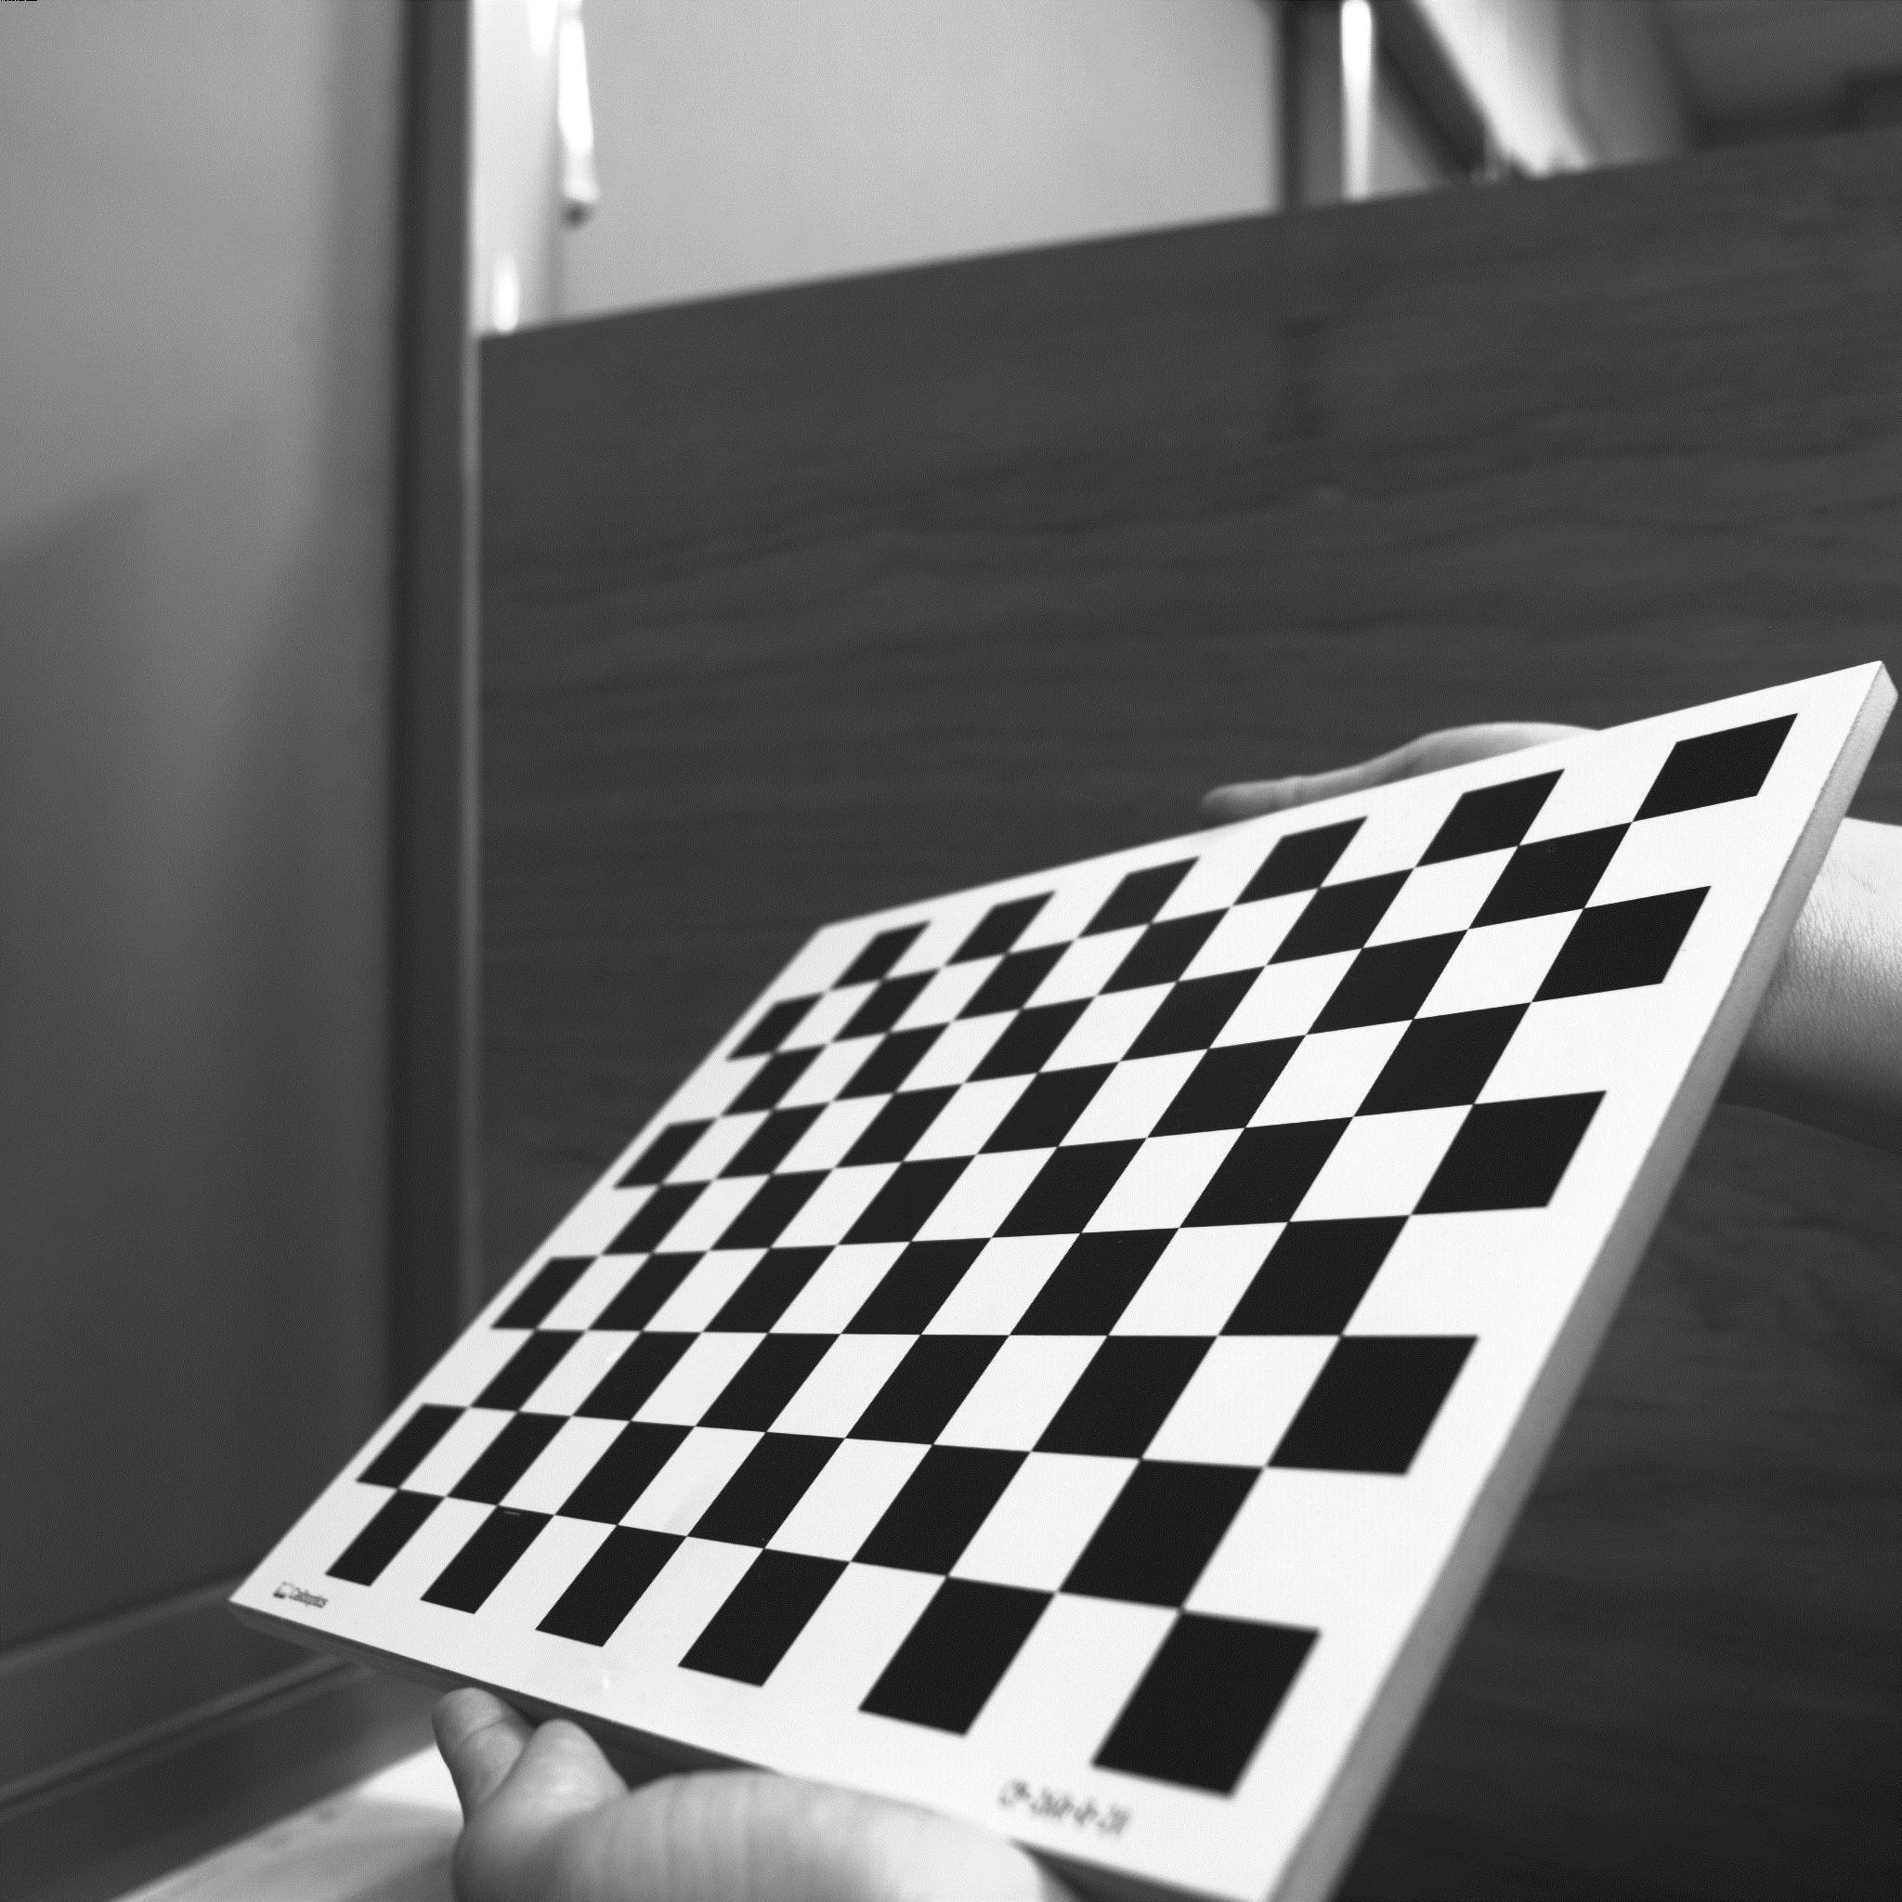
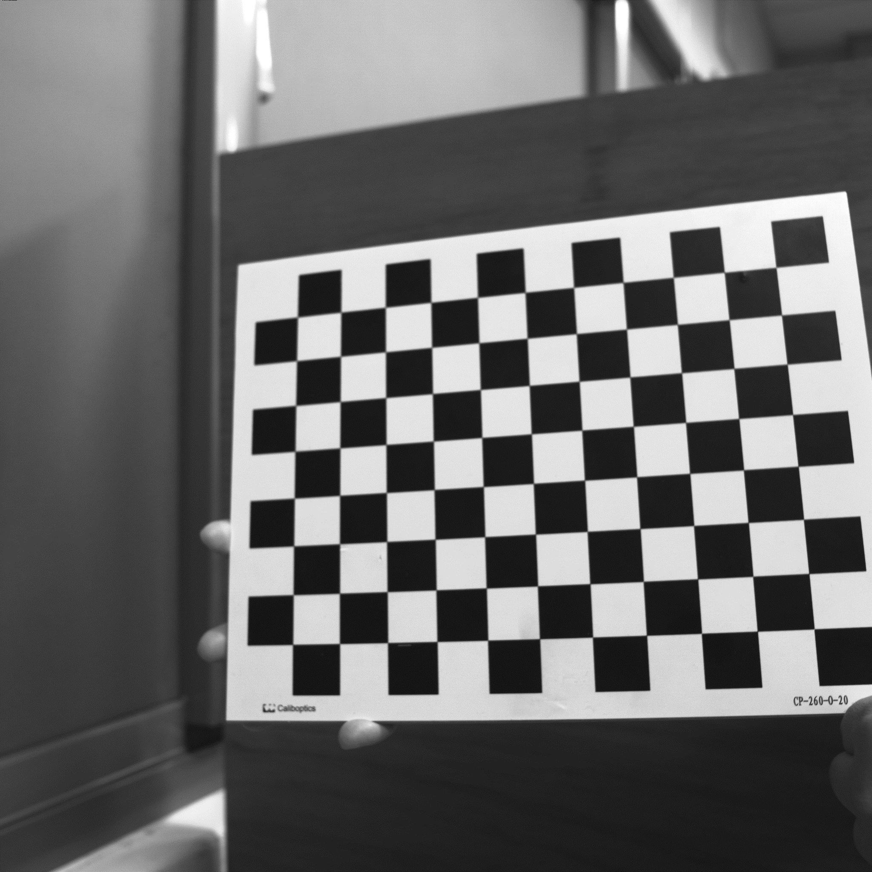
2. (20%) Augmented Reality
(出題：Ming)
Guides and Requirements:
How to use the library: (alphabet_lib_onboard.txt, alphabet_lib_vertical.txt)
Use OpenCV function to read and derive the array or matrix of the char Here take ‘K’ in 'alphabet_lib_onboard.txt' for example Ex (Python): fs = cv2.FileStorage('alphabet_lib_onboard.txt', cv2.FILE_STORAGE_READ) ch = fs.getNode(‘K’).mat() ➔ get the lines of ‘K’
ch = [[[2, 2, 0], [2, 0, 0]], [[0, 2, 0], [2, 1, 0]],
[[2, 1, 0], [0, 0, 0]]]
‘K’ consist of 3 lines, so the ‘ch array’ consists 3 pairs of 3D coordinates in Word Frame representing two ends of the line shown in the upper right image.
Chessboard Coordinates
The chessboard x, y, z axis and (0,0,0) coordinate are shown in the bottom left image
Each Char should be place in the order and position shown in the bottom right image
(2,2,0)
(0,2,0)
(2,1,0)
(2,0,0)
(0,0,0)
The coordinates are in Word Frame
(0,0,0)
1
2
3
Y
4
5
6
X
Z
Chessboard Frame
Position and Order

Slide 14
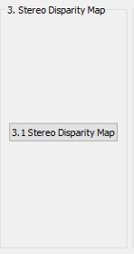
3. (20%) Stereo Disparity Map
(出題：Maton)
3.1 (10%) Stereo Disparity Map
3.2 (10%) Checking the Disparity Value
Load 2 images separately

Slide 15
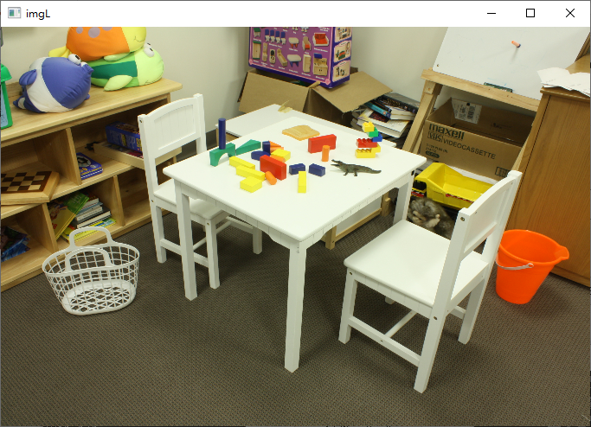
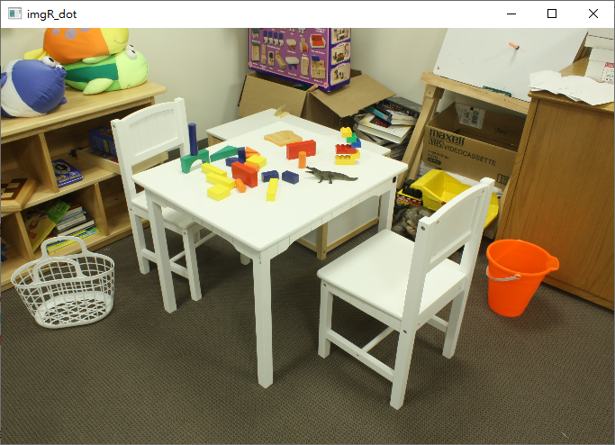
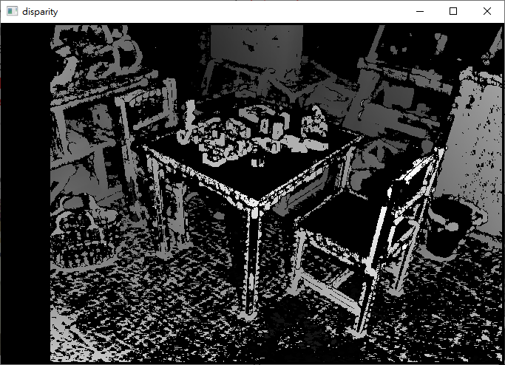
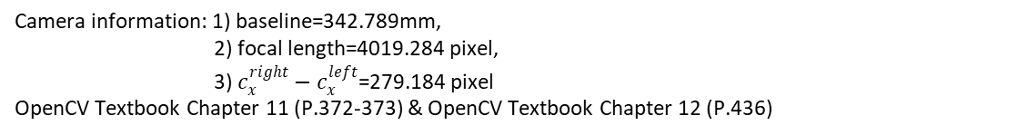
3.1 (10%) Stereo Disparity Map
(出題：Maton)
Given: a pair of images, imL.png and imR.png (have been rectified)
Q:
Find the disparity map/image based on Left and Right stereo images
Guides:
(1) Window Size: Must be odd and within the range [5, 255]
(2) Search range and direction:
Disparity range:
Must be positive and divisible by 16.
Map disparity range to gray value range 0~255 for the purpose of visualization.
If the left image is the reference image (the one used to cal. depth info for each pixel of that Img), then the search direction at right image will go from the right to left direction.
Camera information: 1) baseline=342.789mm,
2) focal length=4019.284 pixel,
3) $c_{x}^{right}−c_{x}^{left}$=279.184 pixel
OpenCV Textbook Chapter 11 (P.372-373) & OpenCV Textbook Chapter 12 (P.436)
Hint: OpenCV Textbook Chapter 12 (P.451)
StereoBM::create(256, 25)
imL.png
imR.png
Result
Left Image (Reference Image)
Right Image
Notes:
https://stackoverflow.com/questions/18870603/in-opencv-python-why-am-i-getting-3-channel-images-from-a-grayscale-image

Slide 16
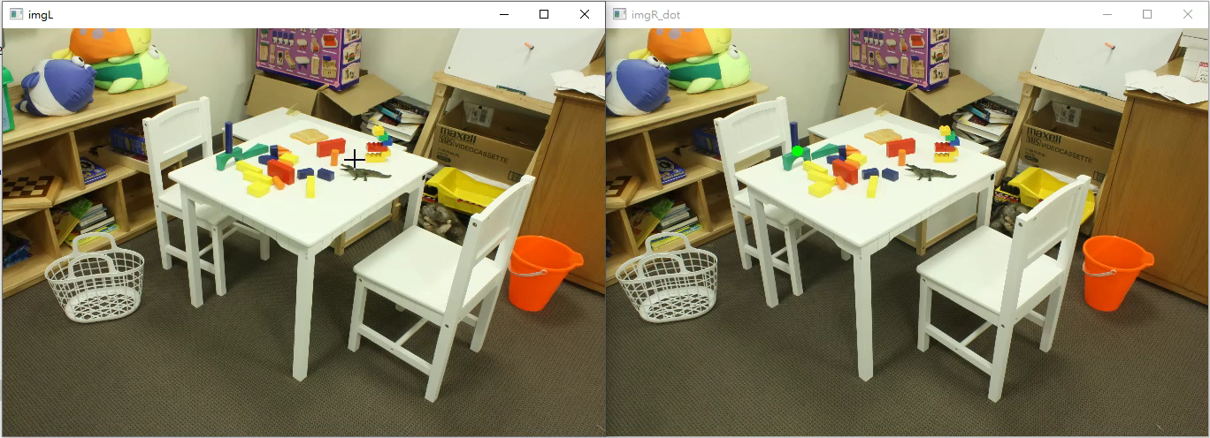
3.2 (10%) Checking the Disparity Value
(出題：Maton)
Given: a pair of images, imL.png and imR.png and disparity map from Q4.1.
Q:
Click at left image and draw the corresponding dot at right image.
1) Click at left image and draw the dot on the right image at accurate position.
2) User should allow to repeat 1).
Note: Click at gray position at disparity map result from Q.4.1, ignore the position with 0 disparity(e.g. Failure case).
Result Video:

